Slide 1


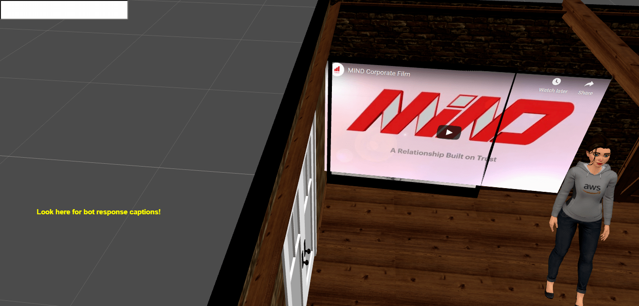


Case Study – AR/VR Chatbot
Project Background
Outputs
Creating a virtual exhibition consisting of an interactive chatbot for voice and text based interactions in a virtual environment. Scenes are organized into a project.
5
90%
Challenges
Accent Issue – supports only US-English
Asset Size – cannot exceed 50 MB
Superimposition of entities – requires translation of individual entities
Using AWS Connect – suitable for large scale projects
Solution provided
Conversational AI
Dialogue Components and State Machines
Transformation of entities
Captioning of the bot responses

